Slide 1
DaxLib.SVG
Jake Duddy

Slide 2






Jake Duddy
Data Platform Microsoft MVP
Fabric Community Super User
EvaluationContext Blog
Devon and Cornwall Power BI Group Co-organizer
evaluationcontext.github.io/
linkedin.com/in/jakeduddy/

Slide 3
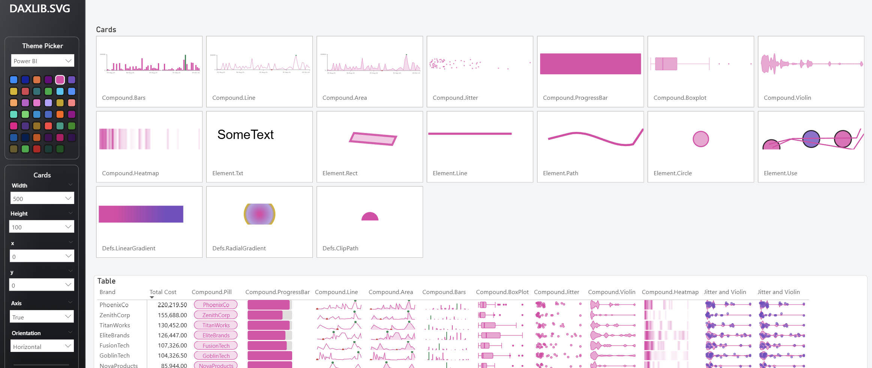
A DAX UDF Library for creating SVG
Notes:
Now we are all up the speed. How about if you didn't have to have all this knowledge

Slide 4
A DAX UDF Library for creating SVG
Notes:
Now we are all up the speed. How about if you didn't have to have all this knowledge

Slide 5
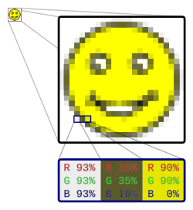
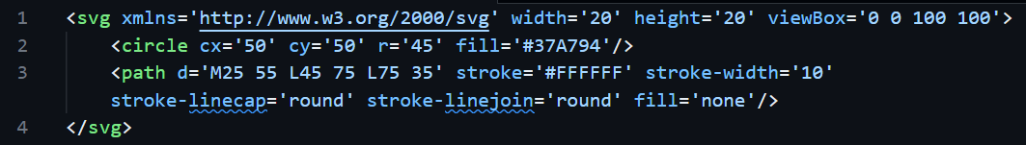

What Are SVGs
Raster | Vector
JPEG, PNG etc Colour per pixel Blurry or pixelated when scaled up or down | SVG Defined as Code Scales to any size without losing quality Animation

Slide 6


0
300
0
Any measures that use SVGs must have DataCategory = "ImageUrl"
130
data:image/svg+xml;utf8,
<svg width='300' height='130' xmlns='http://www.w3.org/2000/svg'> </svg>
<rect width='200' height='100' x='10' y='10' rx='20' ry='20' fill='blue' />
<rect width=‘100' height='100' x='10' y='10' rx='20' ry='20' fill=‘green' />

Slide 7
Our Lego Blocks
Shapes
Rectangles <rect>
Circles <circle>
Ellipses <ellipse>
Lines <line>
Polygons <polygon>
Path <path>
Text <text>
Filters <feGaussianBlur> <feComponentTransfer> …
Animation
foo

Slide 8

Progress Bar
<svg width='500' height='59' xmlns='http://www.w3.org/2000/svg'> <rect width='475' height='50' x='12.5' y='0.5' rx='3' ry='3' fill='#E1DFDD'/>
<rect width='380' height='50' x='12.5' y='0.5' rx='3' ry='3' fill='#E044A7' </svg>

Slide 9
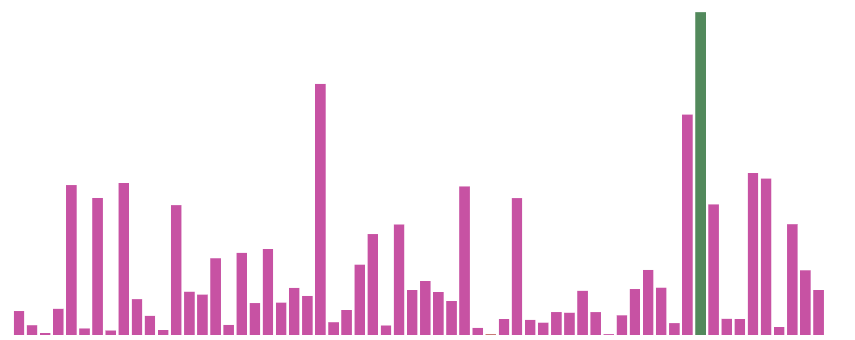
Bar Chart
<svg width='500' height='200' xmlns='http://www.w3.org/2000/svg'> <rect width='6.12' height='13.98' x='13.2' y='182' rx='3' ry='3' fill='#E044A7'/>
…
<rect width='6.12' height='5.6' x='20.9' y='182' rx='3' ry='3' fill='#E044A7'/> </svg>

Slide 10
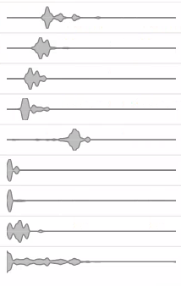
Violin Plot
Shows distribution of data across a scale
Good at identifying multiple data groupings, which can be missed with box and whisker
https://evaluationcontext.github.io/posts/SVG-Violin/

Slide 11
Kernel Density Estimation (KDE)
Value
Different Kernels can be used (normal, uniform, gaussian etc.)
Kernel bandwidth with smooth
Sampling rate will affect fitting

Slide 12
Bézier Curves
Bézier Curves are defined by start and end point, plus 1 or more control points, which act like gravity pulling the curve towards them
In SVG paths the cubic curve is specified by
C x1 y1, x2 y2, x y
S x2 y2, x y
assumes the first control point is a reflection of the one used previously in the path
Link

Slide 13
Control Points
Value
Assume control points are mid point between KDE points

Slide 14
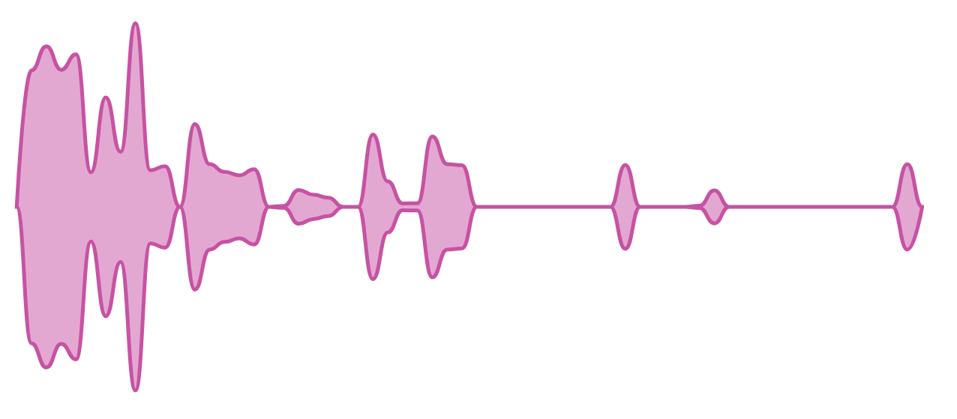
Violin Plot
<svg width='250' height='100' xmlns='http://www.w3.org/2000/svg'> <path d='M 6.25 50 S 8.2 13.5, …’ ‘fill='#E044A7’ fill-opacity=‘0.5’ stroke='#E044A7’></path> </svg>
https://evaluationcontext.github.io/posts/SVG-Violin/?h=vio#end-result-code

Slide 15
A DAX UDF Library for creating SVG

Slide 16
What are DAX UDFs
User Defined Functions ≠ User Data Functions
Build your own DAX functions that you can call like any other DAX function
DRY (Don't Repeat Yourself)
Code that is repeated multiple times can be encapsulated in a single function
Doesn't improve performance
Can make measures simpler/less verbose
Can make bulk updates easier
They are built for semantic model authors

Slide 17
Model-dependent & Model-independent
Model Dependent
Has expectations on semantic model schema
Model Independent
Has NO expectations on semantic model schema

Slide 18
A DAX UDF Library for creating SVG

Slide 19
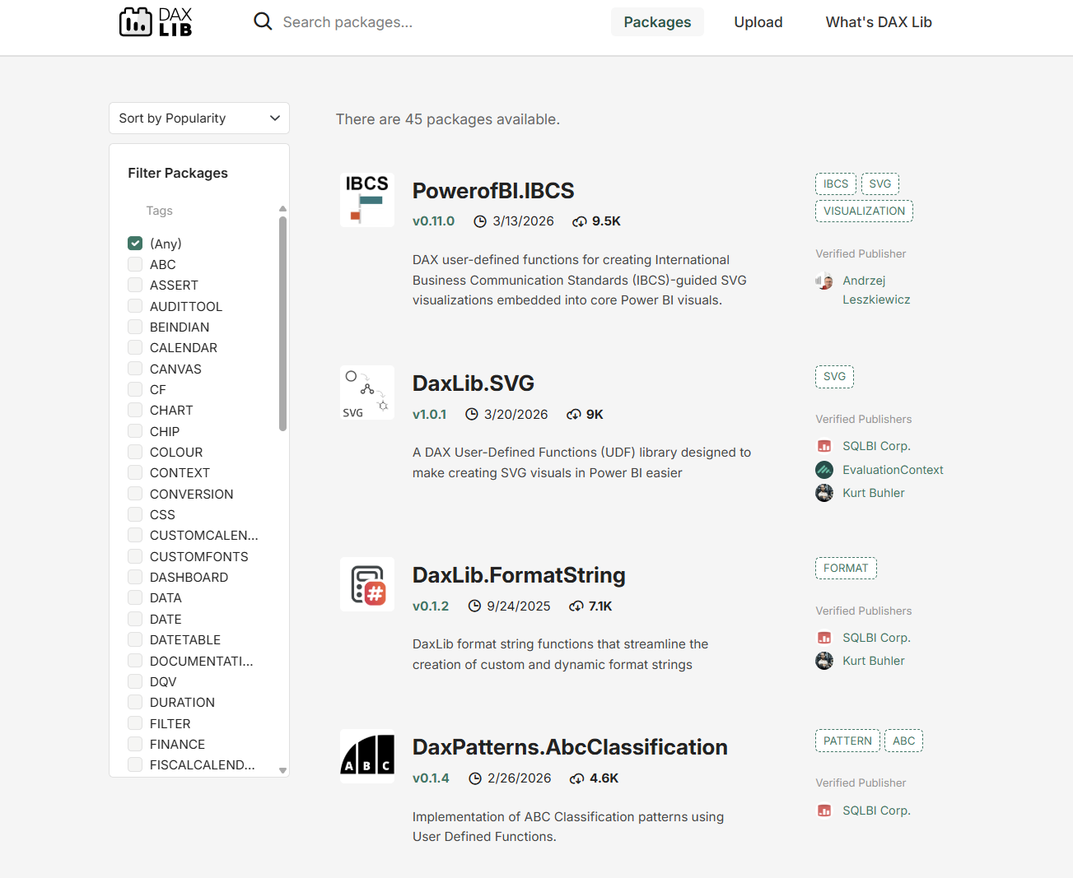

Slide 20
Colours
Elements
Defs
Attributes
Transforms
Scales
…
Compounds
Viz

Slide 21
Colours
Elements
Defs
Attributes
Transforms
Scales
…
Compounds
Viz

Slide 22
Performance & Testing
AI
Open Source

Slide 23
Performance & Testing
AI
Open Source

Slide 24
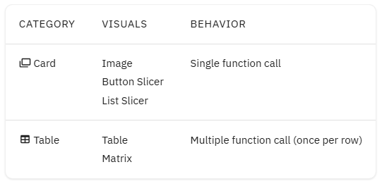

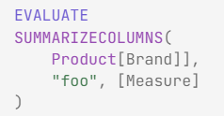

Performance – Testing Suite
Used to validated UDF optimzations
Contoso 1 Million Row Dataset

Slide 25
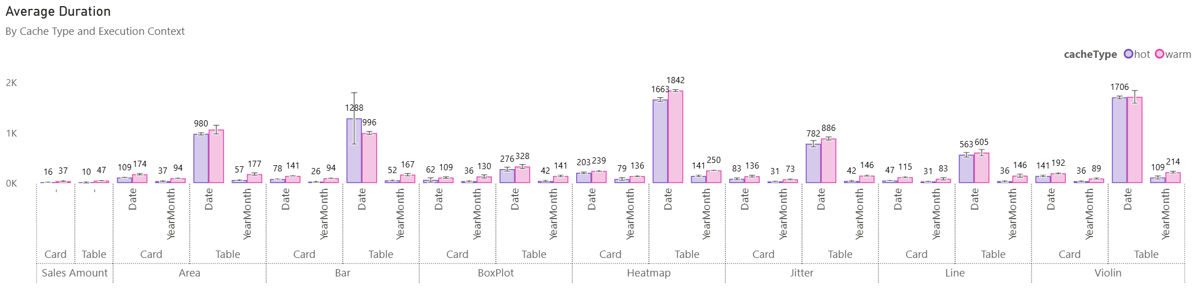
Performance – Testing Suite
DAX Performance Testing Notebook
3 queries per measure, hot and warm cache
High and low granularity axis
Notes:
If we look at Compound, Context and Granularity we can first see that there isn't a huge difference between warm and hot cache. This hints that each measure is likely relying on a lot of Formula Engine (FE) vs Storage Engine (SE), which is not unexpected. All of the daxlib.svg.compound.* functions have a similar construction and although I have tried to calculate a data table early to aid with generating a reusable data cache, there is still a decent amount of string manipulation which will require a reasonable amount of FE involvement. Secondly we can see the impact of the choice of xAxis. The increased granularity of 'date'[Date] vs 'date'[Year Month] has a large effect for many of the daxlib.svg.compound.* functions. The Heatmap and Violin plots are the slowest, which is to be expected since they have additional processing over the other daxlib.svg.compound.* functions. They both need to sample data across the data range; see my previous blog post on SVG Violin plot for info on how and why this sampling occurs.

Slide 26
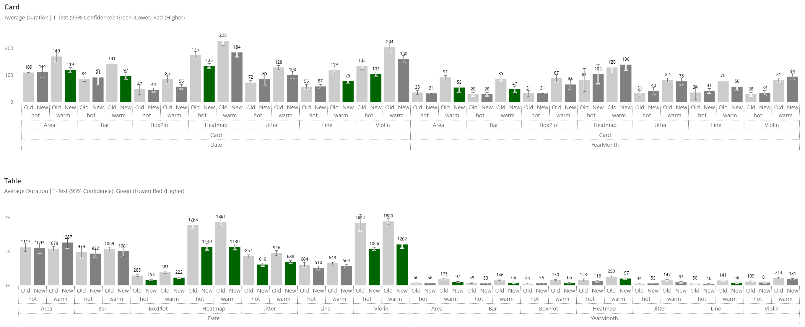
Performance – v0.2.3

Slide 27
Performance & Testing
AI
Open Source

Slide 28
Performance & Testing
AI
Open Source

Slide 29



Contributing
https://docs.daxlib.org/contribute/daxlib-libraries
https://github.com/daxlib/dev-daxlib-svg
Jake Duddy
Tom Shanley
Kurt Buhler
EvaluationContext
tomshanley
data-goblin

